Slide 1


Sampling Survey Analysis on
the Health Insurance Costs of US citizens
By group 14 members:
Ayanda Ndlovu (217001859)
Yasthika Ramgobin (214517334)
Siphesihle Khumalo (219002362)

Slide 2

The Importance of Health Insurance
The need for people of any age to be covered by some health insurance is becoming increasingly popular in today’s world.
Health insurance is a way of paying for one’s medical bills and health care costs.

Slide 3
Aim of our Study
To estimate the average annual health insurance costs (excess charges) of a beneficiary residing in the US.
To estimate the proportion of beneficiaries whose health insurance costs amount to more than $10,000 in a particular year.
By drawing a sample from our population of interest, using four different sampling techniques, namely:
Simple Random Sampling Without Replacement (SRS)
Simple Random Sampling With Replacement (SRS WR)
Stratified Simple Random Sampling
Cluster Simple Random Sampling

Slide 4

The dataset
There are numerous factors that may influence the health insurance costs (charges) of US citizens, for example:
Age
BMI
Number of dependents
Smoker/Non-smoker
Region
A total population size of 1337 healthcare insurance beneficiaries were to be used for our analysis.

Slide 5

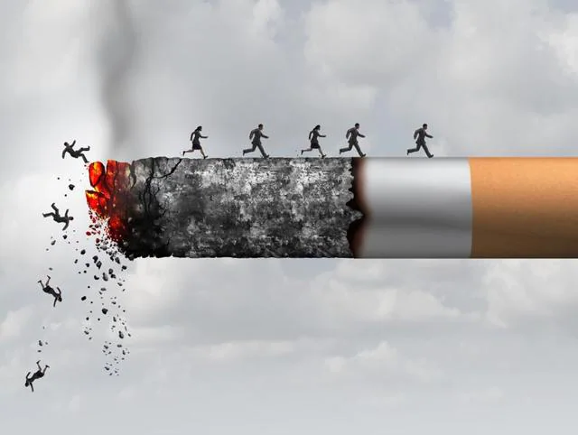


Variables of Interest
Charges represents the amount on medical costs (in US dollars) a beneficiary has to pay at a given year-end Main variable of Interest
Smoker indicates whether the beneficiary is a smoker or not smoking leads to many health problems smokers may have higher charges than non-smokers
Stratification variable
Region represents the residential area of the beneficiary in the US each area is likely to consists of individuals whose charges differ from one another Cluster variable

Slide 6

SAMPLING TYPES
We used the following probability sampling methods to obtain results for our estimates of the average charges and the proportion of individuals whose charges are higher than $10,000:
Simple Random Sampling Without Replacement (SRS)
For SRS, a sample of 225 individuals was randomly selected from the population of 1337 individuals without replacement.
The sample size of 225 was calculated by specifying a margin of error of no more than $1,500 and then conducting SRS on a small (pilot) sample to obtain its variance.
Simple Random Sampling With Replacement (SRS WR)
For SRS WR, a sample of 225 individuals was randomly selected from the population of 1337 individuals with replacement.

Slide 7
SAMPLING TYPES
Stratified SRS:
The variable smoker (categorised as either yes or no) was used as the stratification variable, thus the population of 1337 was divided into two groups (strata), i.e., non-smoker (1063) and smoker (274)
Thereafter, SRS was conducted independently within each stratum, giving us a total sample size of 225.
Cluster SRS:
The variable region (categorised as either northeast, southeast, southwest or northwest) was used as the cluster variable, thus the population of 1337 was divided into four groups (clusters) where each cluster was not of equal size.
Thereafter, SRS was conducted and randomly selected 2 out of the 4 clusters to form the sample, giving us a total sample size of 688.

Slide 8
Thought behind choice of Stratification variable and Cluster Variable
Stratum means differ a lot from each other
Similarity within strata
Cluster means are similar to each other
Similarity between clusters
$32,050.23
$14,735.41
$13,406.38
$12,346.94
$12,450.84
$8,440.66

Slide 9
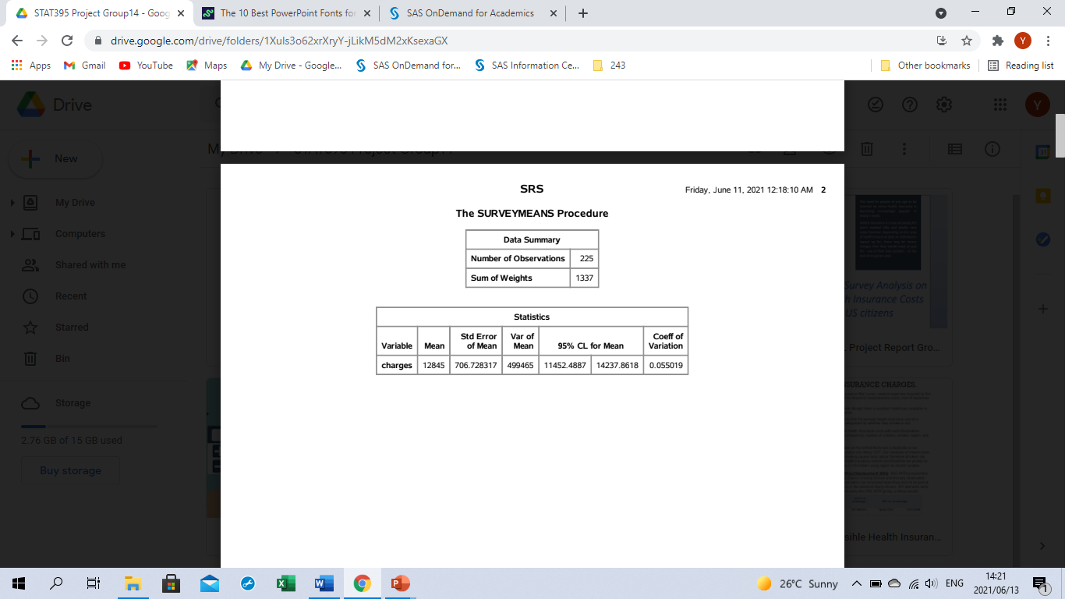
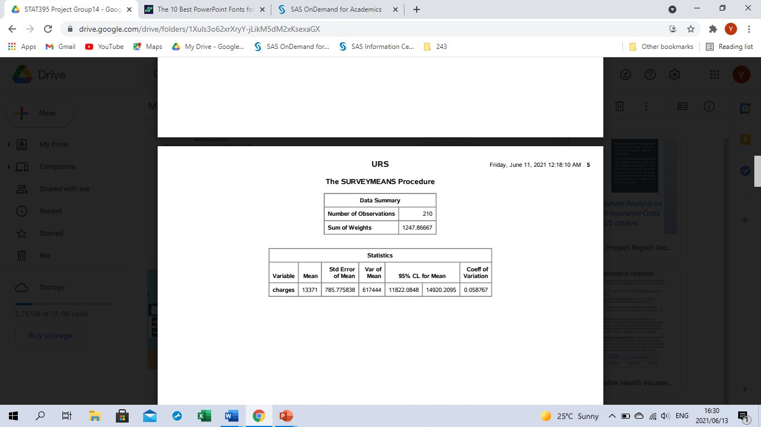
Results (for estimating the annual charges of a typical health insurance beneficiary in the US)
Simple Random Sampling
Without Replacement:
Estimated average charges is: $12,845
Estimated standard error of the average charges is: $706.73
Estimated 95% confidence interval for the average charges is given by: ($11,452.49; $14,237.86)
Simple Random Sampling
With Replacement:
Estimated average charges is: $13,371
Estimated standard error of the average charges is: $785.78
Estimated 95% confidence interval for the average charges is given by: ($11,822.08; $14,920.21)

Slide 10
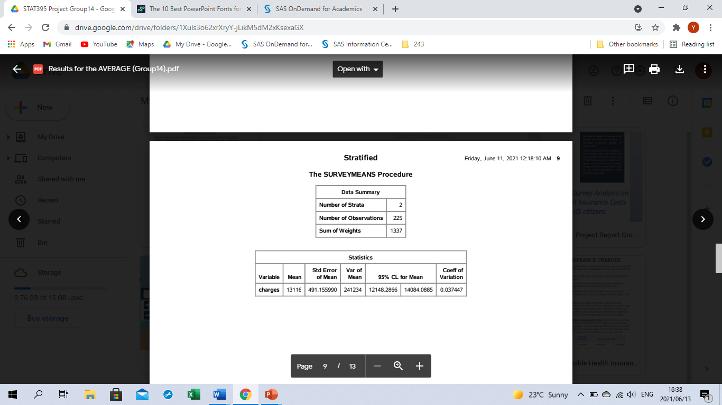
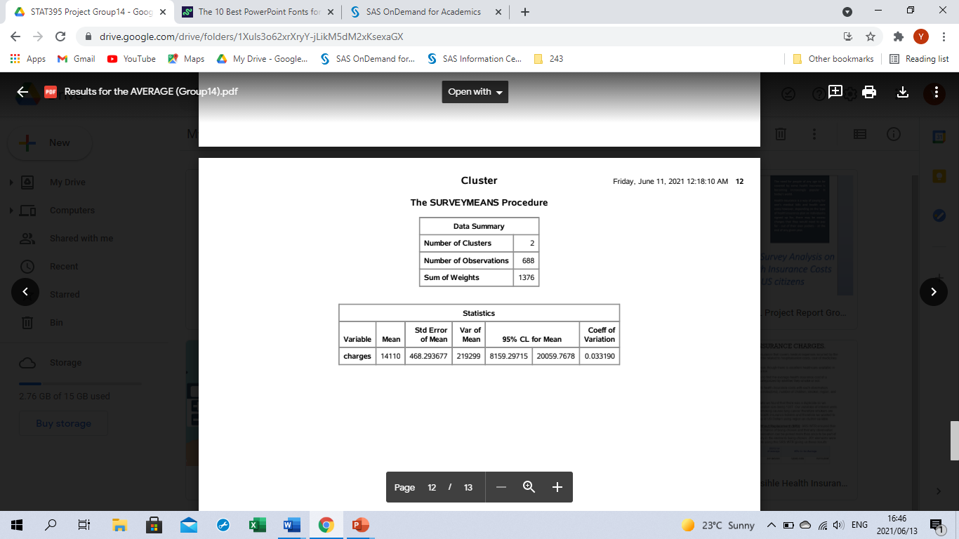
Results continued… (for estimating the annual charges of a typical health insurance beneficiary in the US)
Stratified Simple Random Sampling
Without Replacement:
Estimated average charges is: $13,116
Estimated standard error of the average charges is: $491.16
Estimated 95% confidence interval for the average charges is given by: ($12,148.29; $14,084.09)
Cluster Simple Random Sampling
Without Replacement:
Estimated average charges is: $14,110
Estimated standard error of the average charges is: $468.29
Estimated 95% confidence interval for the average charges is given by: ($8,159.30; $20,059.77)

Slide 11
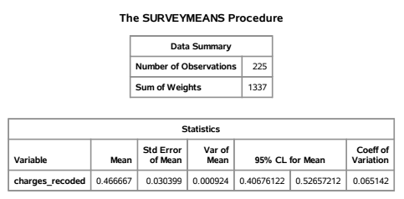
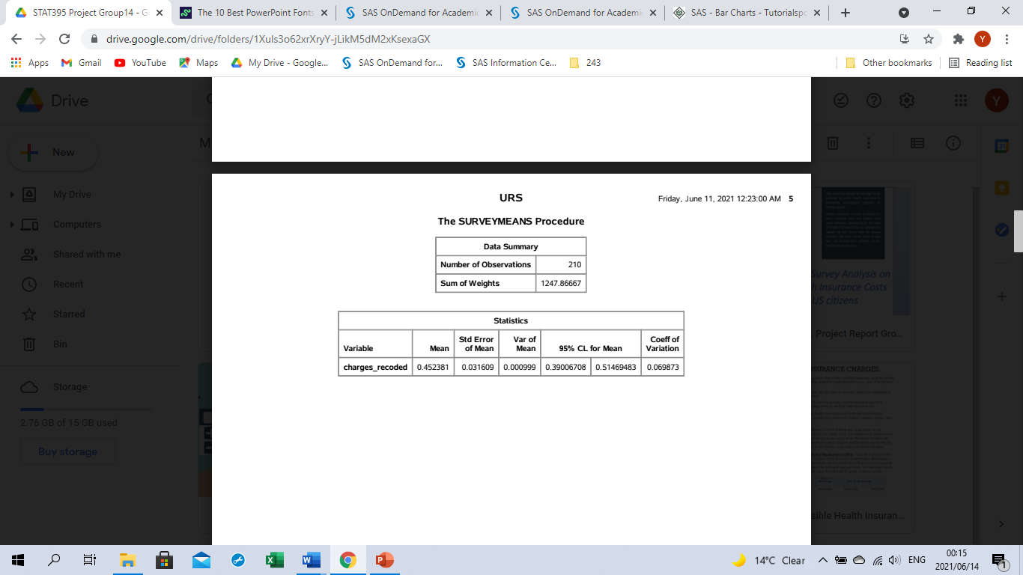
Results (for estimating the proportion of beneficiaries whose annual charges are more than $10,000)
Simple Random Sampling
Without Replacement:
Estimated proportion is: 46.7%
Estimated standard error of the proportion is: 3.04%
Estimated 95% confidence interval for the proportion is given by: (40.7%; 52.7%)
Simple Random Sampling
With Replacement:
Estimated proportion is: 45.2%
Estimated standard error of the proportion is: 3.16%
Estimated 95% confidence interval for the proportion is given by: (39.0%; 51.5%)

Slide 12
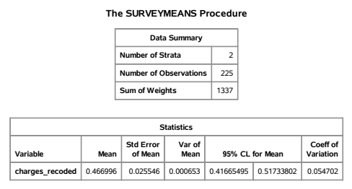
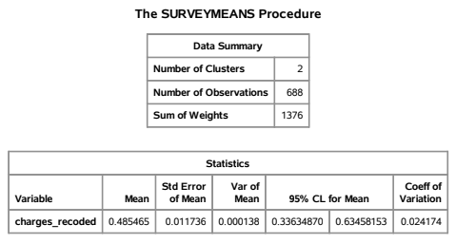
Results continued… (for estimating the proportion of beneficiaries whose annual charges are more than $10,000)
Stratified Simple Random Sampling
Without Replacement:
Estimated proportion is: 46.7%
Estimated standard error of the proportion is: 2.55%
Estimated 95% confidence interval for the proportion is given by: (41.7%; 51.7%)
Cluster Simple Random Sampling
Without Replacement:
Estimated proportion is: 48.5%
Estimated standard error of the proportion is: 1.17%
Estimated 95% confidence interval for the proportion is given by: (33.6%; 63.5%)

Slide 13
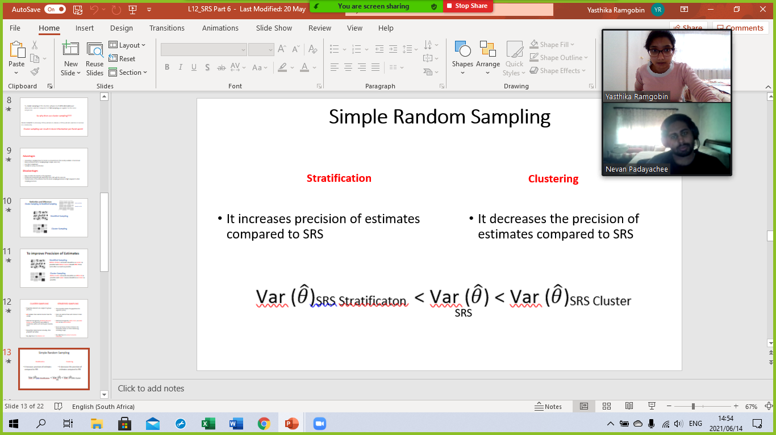
Overall Comparison and Discussion of Results
 | Sampling Type:
AVERAGE: | SRS | SRS WR | Stratified SRS | Cluster SRS
Estimated Average Charges ($) | 12,845 | 13,371 | 13,116 | 14,110
Estimated Standard Error of the Average Charges ($) | 706.73 | 785.78 | 491.16 | 468.29
Estimated 95% Confidence Interval for the Average Charges ($) | (11,452.49; 14,237.86) | (11,822.08; 14,920.21) | (12,148.29; 14,084.09) | (8,159.30; 20,059.77)
C.I. width = 2x error ($) | 2,785.37 | 3,098.13 | 1,935.80 | 11,900.47
PROPORTION: | SRS | SRS WR | Stratified SRS | Cluster SRS
Estimated Proportion (%) | 46.7 | 45.2 | 46.7 | 48.5
Estimated Standard Error of the Proportion (%) | 3.04 | 3.16 | 2.55 | 1.17
Estimated 95% Confidence Interval for the Proportion (%) | (40.7; 52.7) | (39.0; 51.5) | (41.7; 51.7) | (33.6; 63.5)
C.I. width = 2x error (%) | 12 | 12.5 | 10 | 29.9

Slide 14
FINAL THOUGHTS
Given the results from our investigation, we found that:
The sampling method that yielded the best results/most reliable estimates overall was Stratified sampling as it had both – the smallest standard error and narrowest 95% C.I. → more accurate in our estimations of the population parameters of interest.
The estimated average annual health insurance costs of a beneficiary residing in the US is $13,116 and we are 95% sure that the true average of these annual costs is between $12,148.29 and $14,084.09
Similarly, the estimated proportion of beneficiaries whose health insurance costs amount to more than $10,000 in a particular year is 46.7% and we are 95% sure that the true proportion of those beneficiaries is between 41.7% and 51.7%

Slide 15


